Slide 1
Labour, Stages and its Physiology

Slide 2
Contents
Definitions
Normal and abnormal labour
Causes of onset of labour
False labour pain and true labour pain
Stages of labour
Physiology of first stage of labour
Physiology of second stage of labour
Mechanism of normal labour
Physiology of third stage of labour

Slide 3
Definition
Labour- Labour is series of events that takes place in the genital organs in an effort to expel the viable product of conception out of the womb through the vagina into the outer world.
- D.C.Dutta
It may occur prior to 37 completed weeks, when it is called preterm labour.
Delivery- Delivery is the expulsion or extraction of viable fetus out of the womb.

Slide 4
Normal labour (Eutocia)
Labour is called normal if it fulfills the following criteria:
        Spontaneous in onset and at term.
        With vertex presentation
        Without undue prolongation
        Natural termination with minimal aids
        Without having any complications affecting the health of mother and/or baby.
Abnormal labour (Dystocia)- Any deviation from the definition of normal labour is called abnormal labour.

Slide 5
Date of onset of labour
It is unpredictable to foretell precisely the exact date of onset of labour.
Calculation from Naegele‘s formula is only a rough guide.
Based on the formula, labour starts approx. on the expected date in 4%, one week on either side in 50%, 2 weeks earlier and 1 week later in 30%, at 42 weeks in 10% and at 43 weeks plus in 4%.

Slide 6
Causes of Onset of labour
Uterine distension
Feto-placental contribution
Oestrogen
Progesterone
Prostaglandins
Oxytocin
Neurological factors

Slide 7
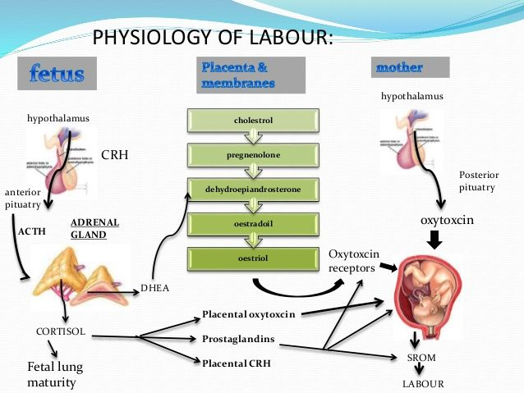

Slide 8
Estrogen
Increase the release of oxytocin from maternal pituitary.
Promotes the synthesis of receptors for oxytocin in the myometrium and decidua.
Accelerates lysosomal disintegration in amnion cells resulting in amnion cells resulting in increased prostaglandin synthesis.
Stimulates the synthesis of myometrial contractile protein ---actinomyosin through cAMP.
Increases the excitability of the myometrial cell membranes.

Slide 9
Progesterone
Increased fetal production of dehydroepiandrosterone sulphate (DHEA-S) and cortisol inhibits the conversion of fetal pregnenolone to progesterone. Progesterone levels therefore fall before labour.
The alteration in the oestrogen:progesterone ratio rather than the fall in the absolute concentration of progesterone which is linked with the prostaglandin synthesis.

Slide 10
Prostaglandins
Prostaglandins are the important factor which initiate and maintain labour.
The major sites of synthesis of prostaglandins are --- amnion, chorion, decidual cells and myometrium.
Synthesis is triggered by –rise in oestrogen level, glucocorticoids, mechanical stretching in the late pregnancy, increase in cytokines, infection, vaginal examination, separation or rupture of membranes

Slide 11
Oxytocin
Oxytocin receptors are increased in the uterus with the onset of labour.
Oxytocin promotes the release of prostaglandins from the decidua.
Oxytocin synthesis is increased in the decidua and in the placenta.
Vaginal examination and amniotomy cause rise in maternal plasma oxytocin level (Ferguson reflex).

Slide 12
Neurological factor
Both α and β adrenergic receptors are present in the myometrium; oestrogen causing the α receptors and progesterone the β receptoors to function predominantly.
The contractile response is initiated through the α receptors of the post ganglionic nerve fibres in and around the cervix and the lower part of the uterus.

Slide 13
False labour pain
Features-
Dull in nature and usually confined to the lower abdomen and groin.
Continuous and unrelated with hardening of the uterus
Without any effect on dilatation of the cervix.
Usually relieved by medications.

Slide 14
Pre labour (premonitory stage) Begins:
Primigravida: 2 or 3 weeks before the onset of true labour.
Multigravida: few days prior.

Slide 15
Features of prelabour
Lightening
Cervical changes
Appearance of false pain

Slide 16
True Labour pain
Features-
Painful uterine contractions (labour pain) at regular intervals
Contraction with increasing intensity and duration
Show
Progressive effacement and dilatation of the cervix
Formation of the bag of waters.

Slide 17
Stages of labour
            First stage of labour
            Second stage of labour
            Third stage of labour
            Fourth stage of labour

Slide 18
First stage of labour
This starts from the onset of true labour pain and ends with full dilatation of cervix. It is in other words, the cervical stage of labour.
Its average duration is 12 hours in primigravida and 6 hours in multigravida.
There are two phases of first stage of labour:
        Latent phase
        Active phase

Slide 19
Phases of first stage of labour
The latent phase:
It is the time between the onset of labour and 3- 4 cm dilatation and cervix becomes fully effaced.
It usually lasts between 3 and 8 hours, being shorter in multiparous women.

Slide 20
Phases of first stage of labour
The second phase:
It is the active stage and describes the time between the end of latent phase (3-4 cm dilatation) and full dilatation (10cm).
It is also variable in length, usually lasting between 2 and 6 hours.It is shorter in multiparous women.
During active phase Cervical dilatation during the active phase usually occurs at 1cm/hour or more in a normal labour.

Slide 21
Second stage of labour
It starts from the full dilation of the cervix and ends with expulsion of fetus from the birth canal. Average duration is 2 hours in primigravida and 1 hour in multipara.
It has got two phases-
Propulsive phase- starts from full dilatation upto the descent of the presenting part to the pelvic floor
Expulsive phase- is distinguished by maternal bearing down efforts and ends with delivery of the baby.

Slide 22
Third stage of labour
The third stage begins after the expulsion of fetus and ends with expulsion of placenta and membranes; it also involves the control of bleeding.
A third stage lasting more than 30 minutes should be considered abnormal.

Slide 23
Fourth stage of labour
The fourth stage begins with the delivery of the placenta and ends two hours later.

Slide 24
Physiology of first stage of labour
Uterine action
Fundal dominance:
Each uterine contraction starts in the fundus near one of the cornua and spreads across and downwards.
The contraction lasts longest in the fundus where it is also most intense, but the peak is reached simultaneously over the whole uterus and the contraction fades from all parts together.

Slide 25
Physiology of first stage of labour
Polarity
Polarity is the term used to describe the neuromuscular harmony that prevails between the two poles or segments of the uterus throughout labour. During each uterine contraction, these two poles act harmoniously.
The upper pole contracts strongly and retracts to expel the fetus; the lower pole contracts slightly and dilates to allow expulsion to take place. If polarity is disorganized then the progress of labour is inhibited.

Slide 26
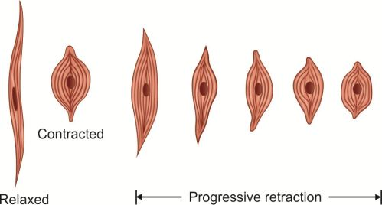

Slide 27
Physiology of first stage of labour
Formation of upper and lower uterine segments
The upper uterine segment, having been formed from the body of the fundus, is mainly concerned with contraction and retraction; it is thick and muscular.
The lower uterine segment is formed of the isthmus and the cervix, and is about 8-10 cm in length. The lower segment is prepared for distention and dilatation.
The muscle content reduces from the fundus to the cervix, where it is thinner.

Slide 28
Physiology of first stage of labour
Formation of upper and lower uterine segments
When the labour begins, the retracted longitudinal fibres in the upper segment pull on the lower segment causing it to stretch; this is aided by the descending presenting part.

Slide 29
The Retraction ring
The ridge forms between the upper and lower uterine segments; this is known as the retraction ring.
The physiological ring gradually rises as the upper uterine segment contracts and retracts and the lower uterine segment thins out to accommodate the descending fetus. Once the cervix is fully dilated and the fetus can leave the uterus, the retraction ring rises no further.

Slide 30
Cervical effacement
Effacement refers to the inclusion of the cervical canal into the lower uterine segment.
It takes place from above downward; that is, the muscle fibres surrounding the internal os are drawn upwards by the retracted upper segment and the cervix merges into the lower uterine segment.
The cervical canal widens at the level of the internal os, where the condition of the external os remains unchanged.

Slide 31
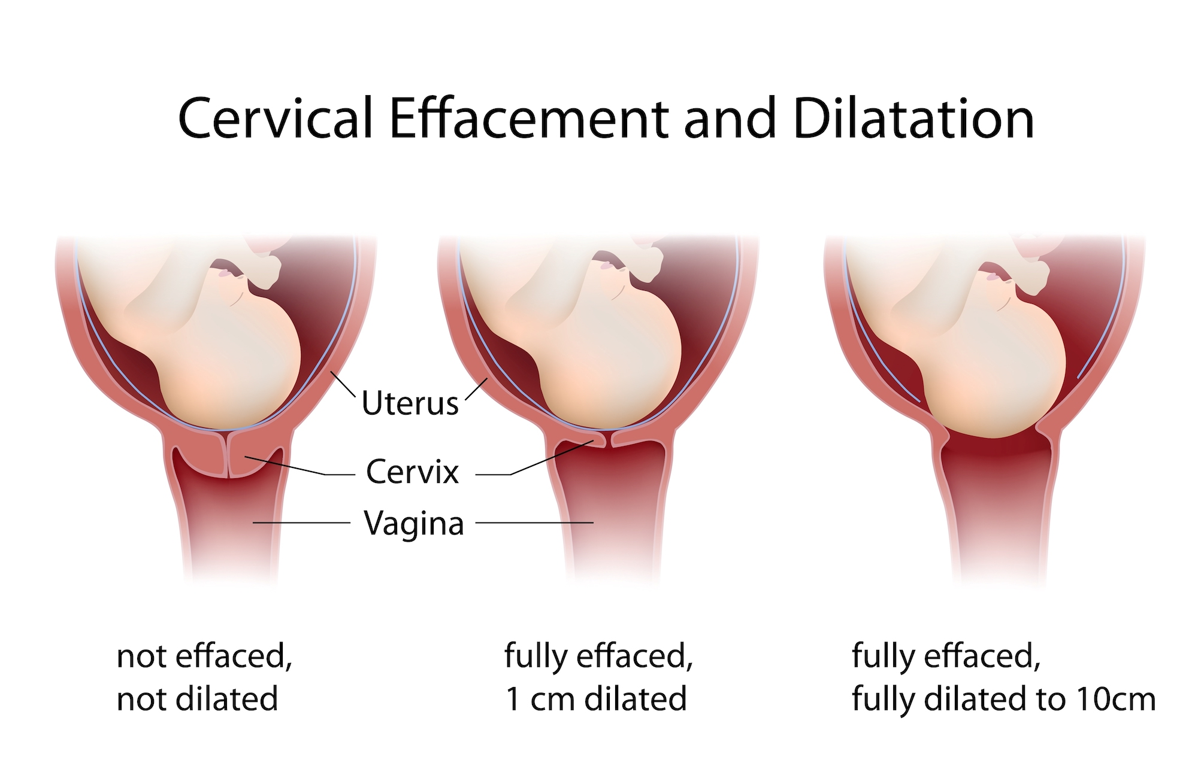

Slide 32
Cervical Dilatation
Dilatation of cervix is the process of enlargement of the os uteri from a tightly closed aperture to an opening large enough to permit the passage of the fetal head. Dilatation is measured in centimeters and full dilatation at term equates to about 10 cm.

Slide 33
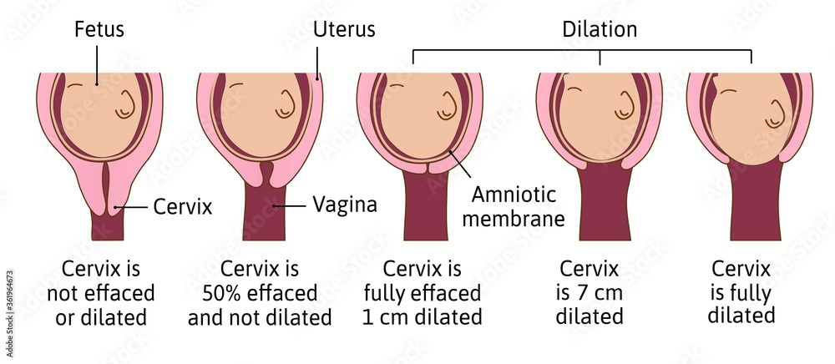

Slide 34
Show-
As a result of the dilatation of the cervix, the operculum, which formed the cervical plug during pregnancy, is lost. The woman may see a blood stained mucoid discharge a few hours before, or within a few hours after, labour starts.The blood comes from the ruptured capillaries in the parietal decidua where the chorion has become detached from the dilating cervix.

Slide 35
Formation of fore water-
As the lower uterine segment forms and stretches, the chorion becomes detached from it and the increased intrauterine pressure causes its loosened part of the sac of fluid to bulge downwards into the internal os, to the depth of 6-12 mm.The well flexes head fits snugly into the cervix and cuts off the fluid in front of the head from that which surrounds the body.

Slide 36
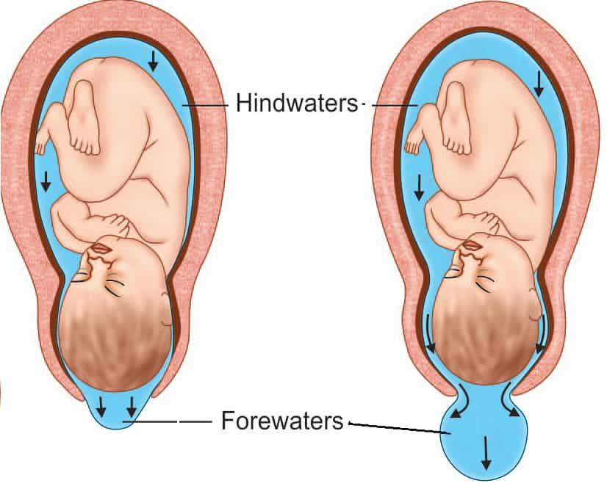

Slide 37
General Fluid Pressure
While the membranes remain intact, the pressure of the uterine contractions is exerted on the fluid and, as fluid is not compressible, the pressure is equalized throughout the uterus and the fetal body; it is known as ‗general fluid pressure‘.

Slide 38
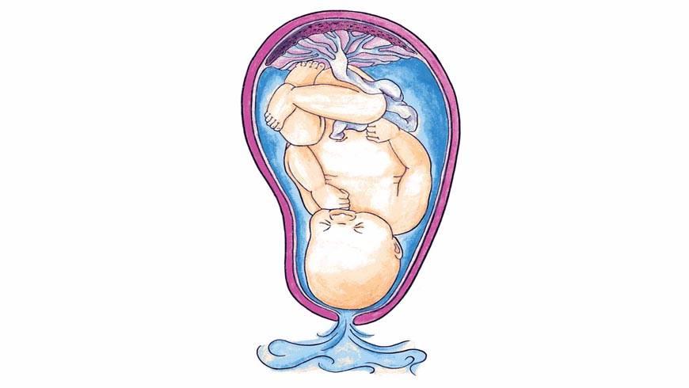
Rupture of membrane-
The optimal physiological time for the membranes to rupture spontaneously is at the end of the first stage of labour after the cervix becomes fully dilated and no longer supports the bag of forewaters.

Slide 39
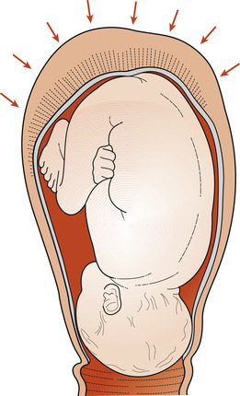
Fetal Axis Pressure-
During each contraction the uterus rises forward and the force of the fundal contraction is transmitted to the upper pole of the fetus down the long axis of the fetus and applied by the presenting part to the cervix. This is known as fetal axis pressure.

Slide 40
Physiology of second stage of labour

Slide 41
Physiology of second stage of labour
Uterine action
Contractions become stronger and longer but may be less frequent, allowing both mother and fetus regular recovery periods.
The membrane often rupture spontaneously towards the end of the first stage or during transition to the second stage.
The consequent drainage of liquor allows the hard, round fetal head to be directly applied to the vaginal tissues. This pressure aids distension.
Fetal axis pressure increases flexion of the head, which results in smaller presenting diameters, more rapid progress and less trauma to both mother and fetus.

Slide 42
Continued..
The contraction becomes expulsive as the fetus descends further into the vagina.
Pressure from the presenting part stimulates nerve receptors in the pelvic floor ―this is termed the ‗Ferguson reflex‘ and the woman experiences the need to push.
The mother‘s response is to employ her secondary powers of expulsion by contracting her abdominal muscles and diaphragm.

Slide 43
Soft tissue displacement
As the hard fetal head descends, the soft tissues of the pelvis becomes displaced.
Anteriorly-Bladder
Posteriorly- Rectum
The levator ani muscles
Perineal body

Slide 44
Continued..
The fetal head becomes visible at the vulva, advancing each contraction and receding between contractions until crowning takes place.
The head is then born.
The shoulders and body follow with next contraction, accompanied by gush of amniotic fluid and sometimes of blood.
The second stage culminates in the birth of the baby.

Slide 45
Presumptive signs of second stage of labour
Expulsive uterine contraction
Rupture of forewaters  Dilatation and gaping of the anus
Appearance of the rhomboid of Michaelas
Show
Appearance of presenting part

Slide 46
Mechanism of normal labour

Slide 47
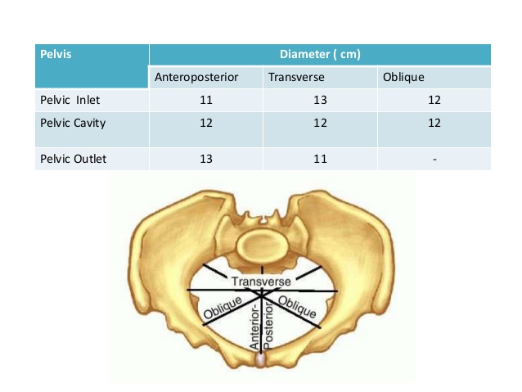
Maternal pelvis

Slide 48
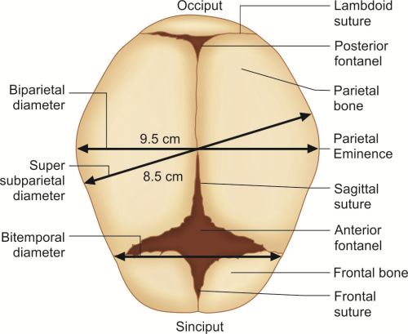
Fetal skull

Slide 49
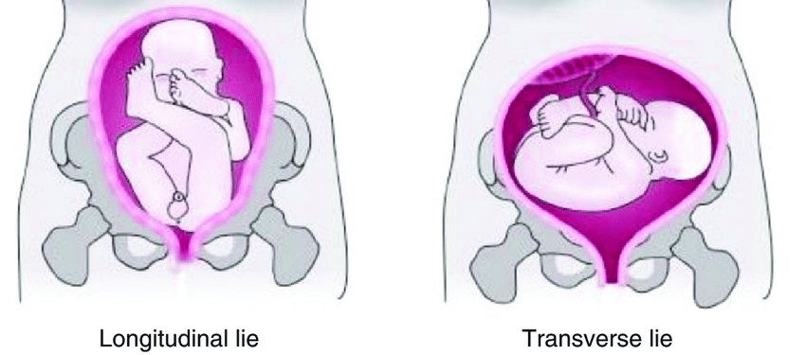
Lie
It refers to the relationship of the long axis of the fetus to the long axis of the centralized uterus or maternal spine.

Slide 50
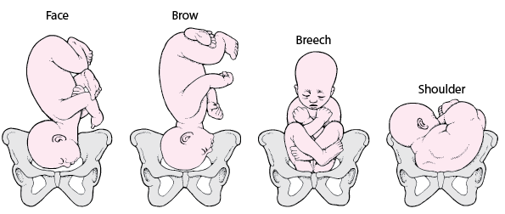
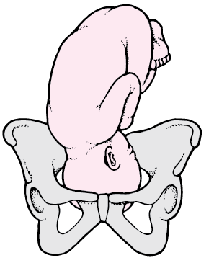
Presentation
Breech presentation- Presentation of the fetal buttocks, knees, or feet in labor.
Cephalic presentation- Presentation of any part of the fetal head in labor, whether the vertex, face, or brow.
Vertex

Slide 51
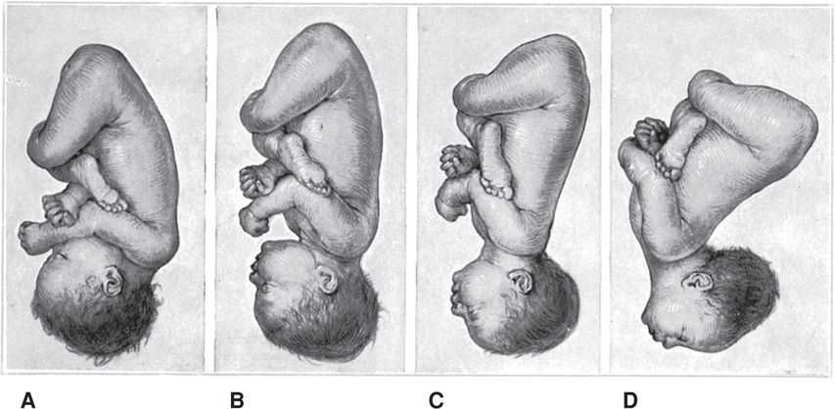
Presenting part
Is defined as the part of the presentation which overlies the internal os and is felt by the examining finger through the cervical opening.

Slide 52
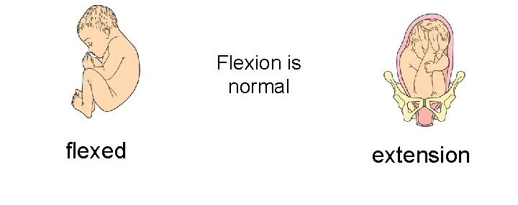
Attitude
The relation of the different parts of the fetus to one another is called attitude of the fetus. The universal attitude is that of flexion.

Slide 53
Denominator
It is an arbitrary bony fixed point on the presenting part which comes in relation with the various quadrants of the maternal pelvis.
The following are denominators of the different presentations- occiput in vertex, mentum in face, frontal eminence in brow, sacrum in breech and acromion in shoulder

Slide 54
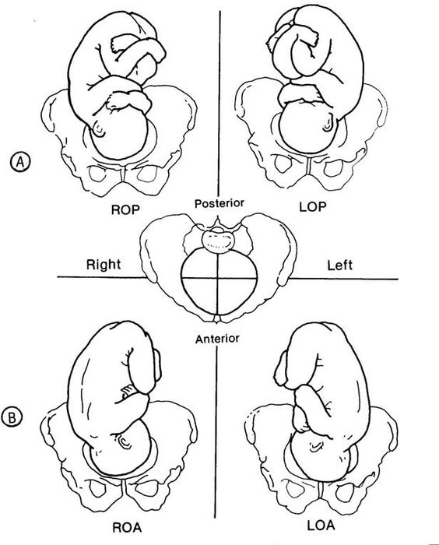
Position

Slide 55
Mechanism of labour
As the fetus descends, soft tissue and bony structures exert pressures which lead to descent through the birth canal by a series of movements. Collectively, these movements are called the mechanism of labour.

Slide 56
Principles common to all mechanism
Descent takes place
hichever part leads and first meets the resistance of the pelvic floor will rotate forwards until it comes under the symphysis pubis.
Whatever emerges from the pelvis will pivot around the pubic bone.

Slide 57
Six considerations for normal labour
The lie is longitudinal
The presentation is cephalic
The position is right or left occipitoanterior
The attitude is one of the good flexion
The denominator is the occiput
The presenting part is the posterior part of the anterior parietal bone.

Slide 58
Cardinal movement
Engagement
↓
Descent
↓
Flexion
↓
Internal rotation
↓
Extension of the head
↓
External rotation/Restitution
↓
Internal Rotation of the shpulders
↓
Expulsion

Slide 59
Engagement
The mechanism by which the biparietal diameter - the greatest transverse diameter in an occiput presentation- passes through the pelvic inlet is designated engagement.

Slide 60
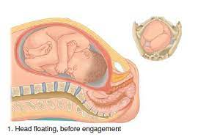

Slide 61
Descent
This movement is the first requisite for birth of the newborn.
Different in nulliparous and multigravid women.
Throughout the first stage of labour the contraction and retraction of the uterine muscles allow less room in the uterus, exerting pressure on the fetus to descend.
Following rupture of the forewaters and the exertion of maternal effort, progress speed up.

Slide 62
Flexion
As soon as the descending head meets resistance, whether from the cervix, walls of the pelvis, or pelvic floor, then flexion of the head normally results.
Suboccipitobregmatic diameter (9.5 cm) is substituted for the longer occipitofrontal diameter (10 cm). The occiput becomes the leading part.

Slide 63
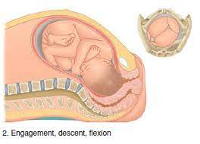

Slide 64
Internal rotation of the head
During contraction, the leading part is pushed downwards onto the pelvic floor. The resistance of this muscular diaphragm brings about rotation.
Occiput gradually moves toward the symphysis pubis anteriorly.
Whichever part of the fetus meets the lateral half of this slope will be directed forwards and towards the center in a well flexed vertex presentation the occiput leads, and rotates anteriorly through 1/8th of a circle when it meets the pelvic floor. This causes a slight twist in the neck as the head is no longer in direct alignment with the shoulders.

Slide 65
The anteroposterior diameter of the head now lies in the widest (anteroposterior) diameter of the pelvic outlet.
The occiput slips beneath the sub-pubic arch and crowning occurs when the head no longer recedes between contraction and the widest transverse diameter is born.
Of flexion is maintained, the suboccipito bregmatic diameter, usually distends the vaginal orifice.

Slide 66
Extension of the head
Once crowning has occurred the fetal head can extend, pivoting on the suboccipital region around the pubic bone.
This releases the sinciput, face and chin, which sweep the perineum and are born by a movement of extension.

Slide 67
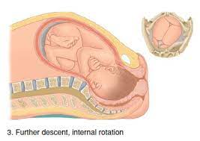

Slide 68
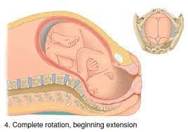

Slide 69
Internal rotation of the shoulders
The shoulders undergo a similar rotation to that of the head to lie in the widest diameter of the pelvic outlet, namely anteroposterior.
The anterior shoulder is first to reach the levator ani muscle and is therefore rotates anteriorly to lie under the symhysis pubis.  It occurs in the same direction as restitution, and the occiput of the fetal head now lies laterally.

Slide 70
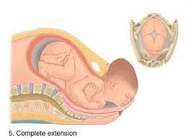

Slide 71
Restitution
The twist in the neck of the fetus that resulted from internal rotation is now corrected by a slight untwisting movement.
The occiput moves one-eight of a circle towards the side from which it started

Slide 72
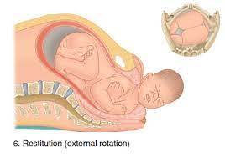

Slide 73
Lateral flexion
Almost immediately after external rotation, the anterior shoulder slips beneath the subpubic arch and the posterior shoulder passes over the perineum.
After delivery of the shoulders, the rest of the body is born by lateral flexion as the spine bends sideways through the curved birth canal.

Slide 74
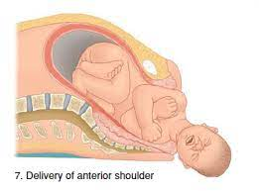

Slide 75
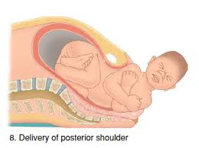

Slide 76
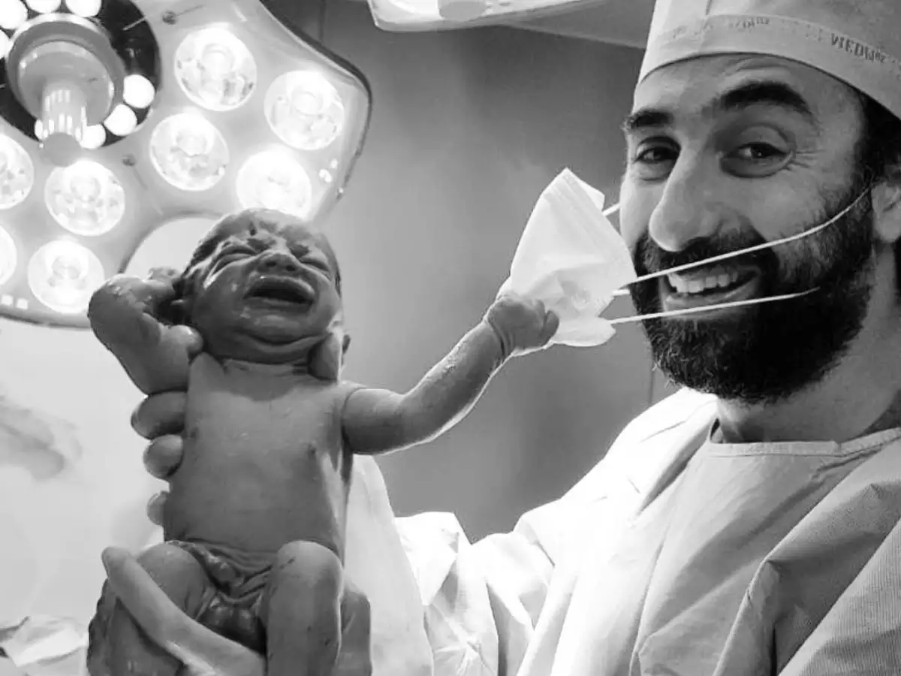
Second stage of labour ends with the delivery of the baby.

Slide 77
Third stage of labour
This stage begins immediately after delivery of the fetus and involves the separation and expulsion of the placenta and membranes, involving the separation, descent and expulsion of placenta and membranes and control of hemorrhage from the placenta site.
The third stage usually lasts between 5 and 15 minutes, but any period upto 30 minutes is considered to be within normal limits.

Slide 78
Mechanical factors
As the neonate is born, the uterus spontaneously contracts around its diminishing contents.
The uterine fundus now lies just below the level of the umbilicus.  Thus, by the beginning of the third stage, the placental site has already diminished in area by about 75%.
As this occurs the placenta becomes compressed and the blood in the intervillous spaces is forced back into the spongy layer of the decidua basalis.

Slide 79
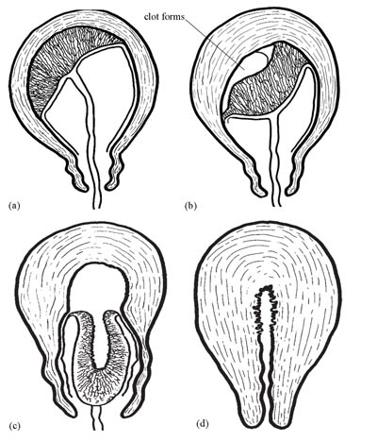

Slide 80
Mechanical factors
Retraction of the oblique uterine muscle fibres exerts pressure on the blood vessels so that blood does not drain back into the maternal system.
The vessels during this process become tense and congested. With the next contraction the distended veins burst and small amount of blood seeps in between the thin septa of the spongy layer and the placental surface, stripping it from its attachment.
As the surface area of the placental attachment reduces, the relatively non elastic placenta begins to detach from the uterine wall.

Slide 81
Schultze method
Separation usually begins centrally so that retroplacental clot is formed.
Increased weight helps to strip the adherent lateral borders and peel the membranes off the uterine wall so that the clot thus formed becomes enclosed in a membranous bag as the placenta descends, fetal surface first.
This process of separation is associated with more shearing of both placenta and membranes and less fluid blood loss.

Slide 82
Matthews Duncan method
The placenta may begin to separate unevenly at one of its lateral borders.
The blood escapes so that separation is unaided by the formation of a retroplacental clot.
The placenta descends, slipping sideways, maternal surface first.
This process takes longer and is associated with ragged, incomplete expulsion of the membranes and a higher fluid blood loss.

Slide 83
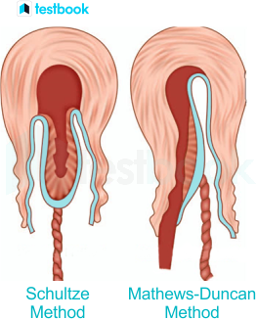

Slide 84
Separation of fetal membranes
The great decrease in uterine cavity surface area simultaneously throws the fetal membranes—the amnion, chorion and the parietal decidua—into innumerable folds.
Membranes usually remain in situ until placental separation is nearly completed.
These are then peeled off the uterine wall, partly by further contraction of the myometrium and partly by traction that is exerted by the separated placenta, which lies in the lower segment or upper vagina.

Slide 85
Homeostasis
Retraction of the oblique uterine muscle fibres in the upper uterine segment through which the tortuous blood vessels interwine- the resultant thickening of the muscles exert pressure on the torn vessels, acting as clamps, so securing a ligature action.
Vigorous uterine contraction following separation-this brings the walls into apposition so that further pressure is exerted on the placental site.  There is transitory activation of the coagulation and fibrinolytic systems during, and immediately following placental separation

Slide 86
Conclusion

